Slide 1
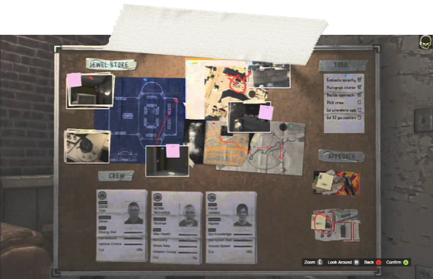


Jackpot
Hacking, Silence & Teamwork.
The 21st Century way of performing the perfect heist.

Slide 2
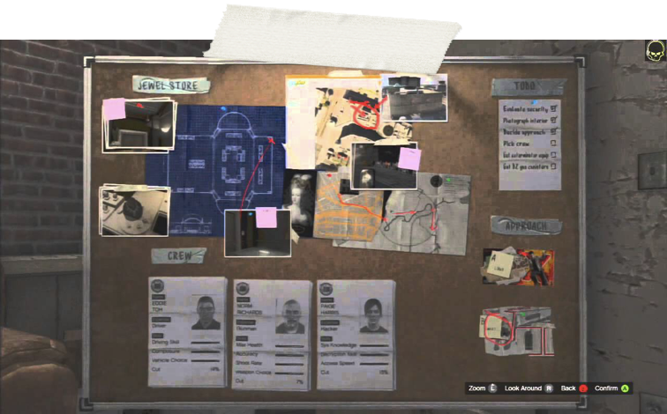

What is Jackpot?
Multi-Player
3D
Cooperative Strategy
Reactive Environment
For PC.

Slide 3
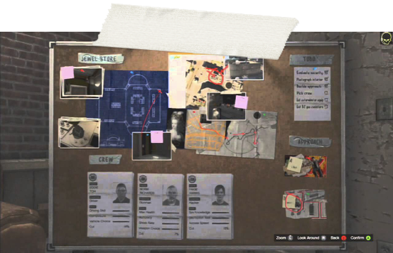
Storyline
A team of 4 daring hackers in search of their next payday,
No buildings secure, these daring hackers loot Casinos, Banks and even Government Vaults,
Always entering & leaving without a trace.

Slide 4
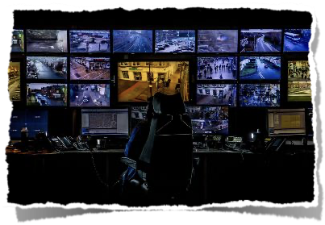
Characters
The Outside Eye - Hawkeye.
The master strategist from outside.
Watching the world, keeping an eye on CCTV & Hacking their way through systems, doors & computers forging the path for the inside squad.

Slide 5
Characters
The Inside Squad. [ 3x ]
The daring ground team. No weapons, pure strategy.
You’d hope it’s simply walk in, find the loot & walk out but with a heist, you never know.
The team will have to pick locks, break in undetected & leave without being spotted.

Slide 6


Market Research - Audience
Varying Levels Of Difficulty!
Best suited for children over 12 & adults due to the nature of game & the environments present.

Slide 7
What makes Jackpot original?
Challenging Game-Play
Co-Operation is essential to team success
Very different inter-game roles
Cool Controllers
Intriguing storyline -
why wouldn’t you want to hack into places like the pentagon???

Slide 8
Technology Stack
For Hawkeye on the outside:
Microsoft HoloLens
Custom-made 3D-Printed Hacker Input Panel [using Arduino!]
For the inside squad [3x]:
Razer Hydra w/ accompanying controllers
Along with 4xPC’s w/ Networking capabilities!

